Slide 1
OUI Bootcamp Capstone
People Analytics Project

Slide 2
Case Study
The Palmoria Group, a manufacturing company based in the Nigeria, is embroiled in issues bordering on gender inequality in its 3 regions. I was assigned the task to analyze the company’s HR data to identify key areas within the business that could spring up issues and come up with recommendations for management’s attention and compute the remunerations.

Slide 3
Executive Summary
Gender is fairly distributed throughout the organization
Average salary is close for both gender categories but there are far more men than women earning between $110,000 - $120,000
Employees ratings are fairly distributed across the genders
Majority of the employees earn salaries below the minimum requirement
The undisclosed gender category may affect the accuracy of this analysis since the focus of the analysis is on gender distribution and pay parity. However, the undisclosed gender category account for only about 4% of the total employees.

Slide 4
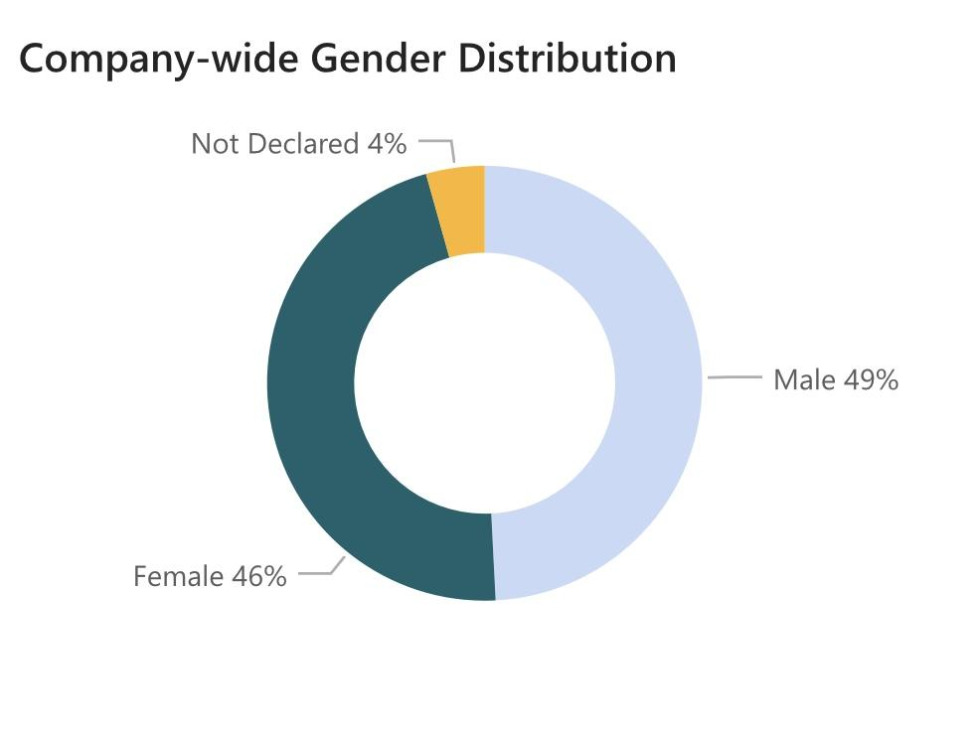
Gender Distribution - Overall
Gender is fairly distributed throughout the company with male population being 3% higher than female.
4% of the employees didn’t disclose their gender.
Notes:
4% of the employees didn’t disclose their gender so it’s hard to say if their percentage would further offset the gender distribution or balance it up

Slide 5
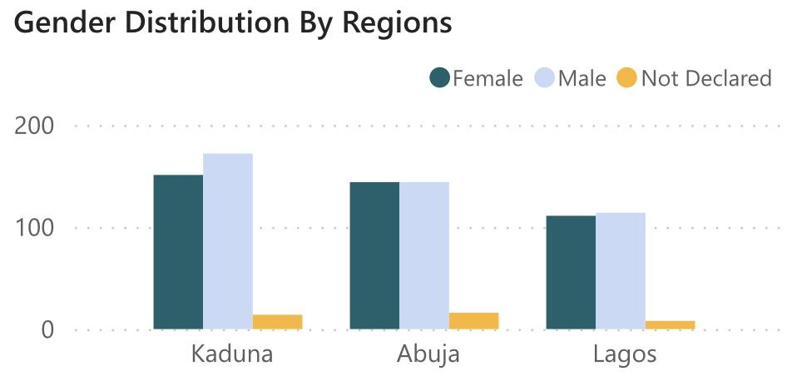
Gender Distribution - Regions
Abuja region has a balanced gender distribution for both genders at 16% each.
Lagos has 3 more males than females.
Kaduna region has the highest gender gap with 21 more males than females
Notes:
Kaduna region has the highest gender gap with 21 more males than females which is about 6% of the total employees in the region

Slide 6
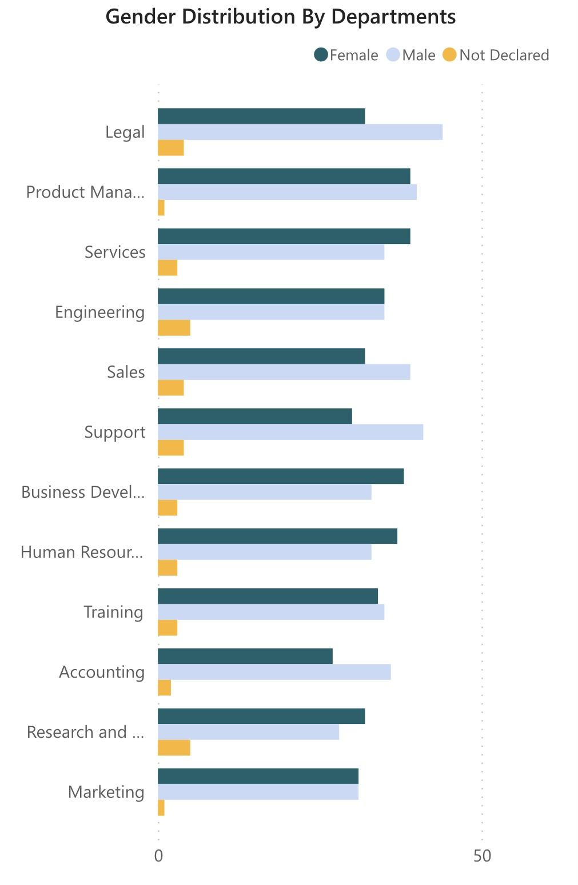
Gender Distribution - Departments
Legal, Support, Accounting are the top 3 departments with most gaps
Marketing and Engineering department are the most balanced with equal number for both genders
Notes:
Legal, Support, Accounting are the top 3 departments with most gaps with 44 males & 32 females, 41 and 30, 36 and 27.
Marketing (31 each) and Engineering (35 each)department are the most balanced with equal number for both genders at 31 each followed by product management and training with one more males than females both departments.
There are more females than males in Services (39/35), Business Development (38/33), Human Resources (37/33) and R&D (32/28)

Slide 7
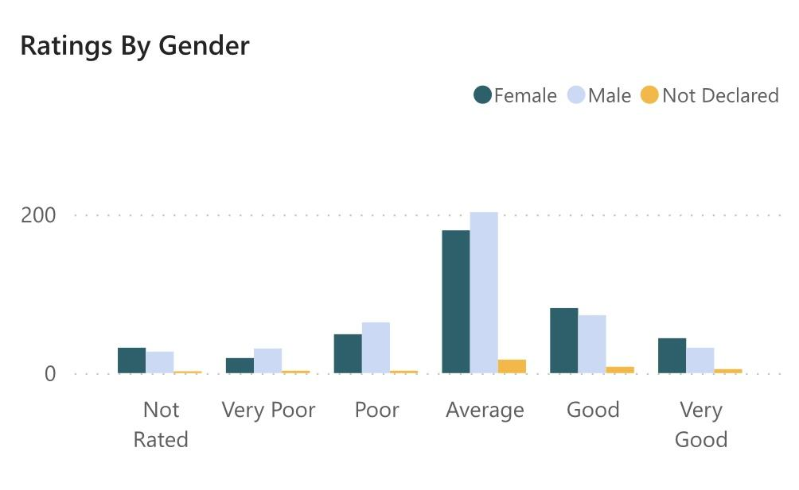
Performance Ratings
Both genders are fairly represented across the rating categories.
Notes:
Females leads the rating pack in Very good, Good and the Not rated categories. While males were more in the average, poor and very poor categories.

Slide 8
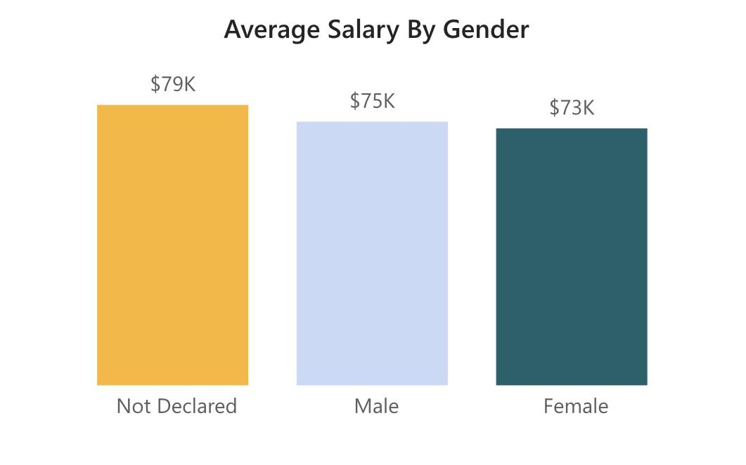
Average Salary By Gender
The average salaries for both genders are close at $75k for male and $73k for female. The undisclosed gender group has the highest average salary at $79k.

Slide 9
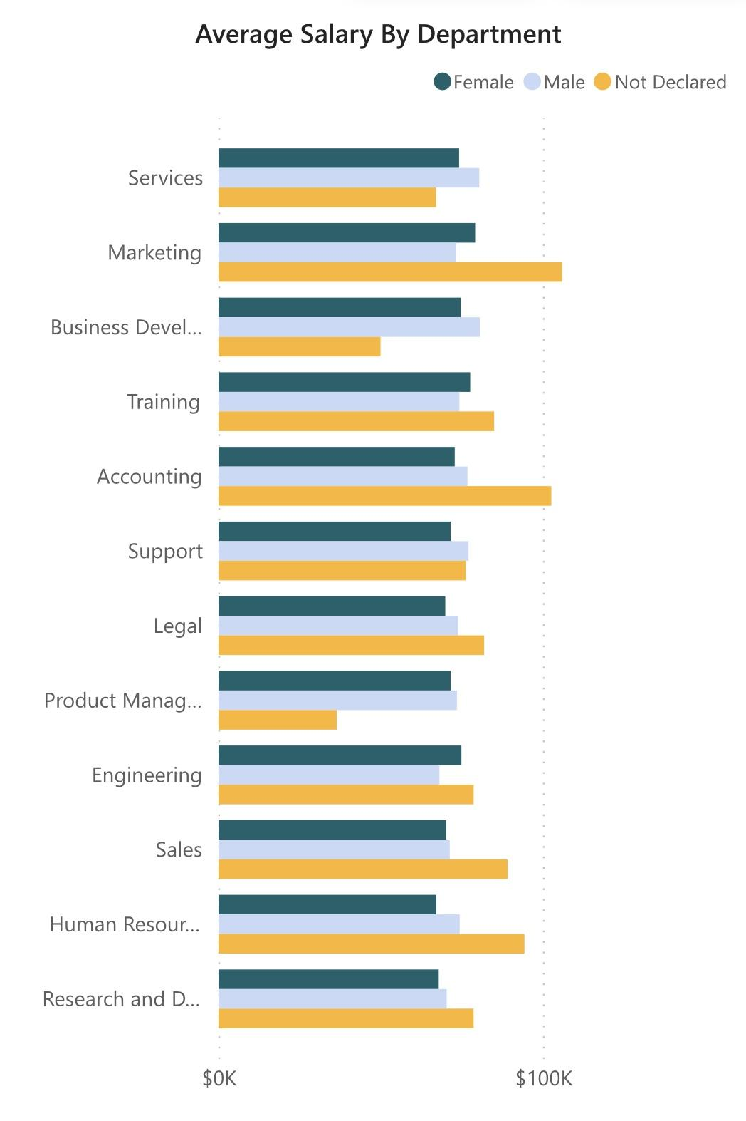
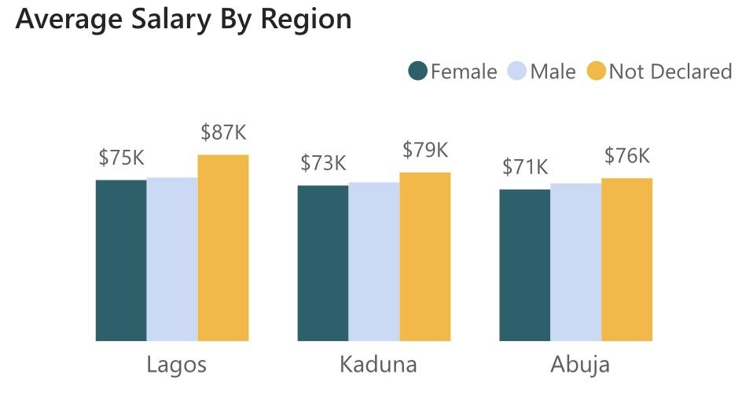
Average Salary - Regions & Departments
Notes:
At regional and departmental levels, the averages are similar to the overall trend with close averages for both men and women.

Slide 10
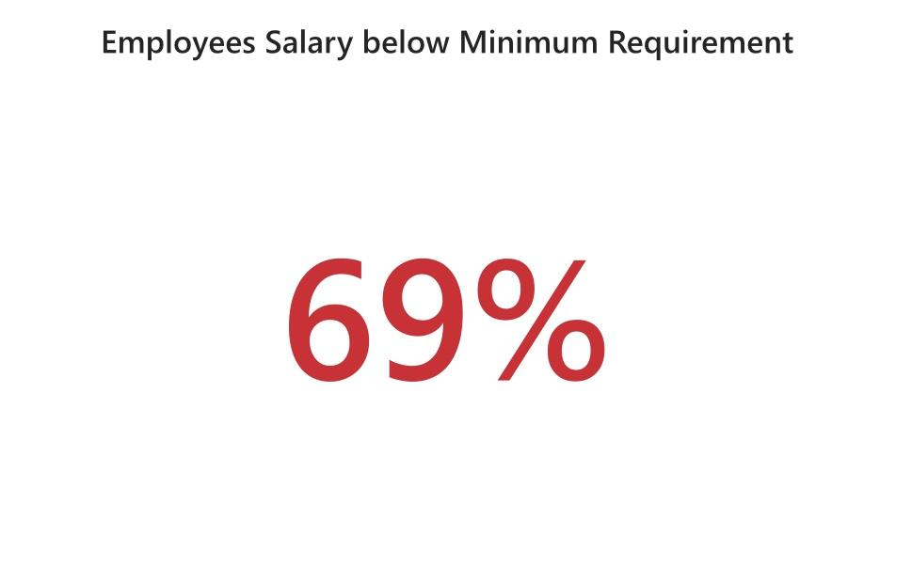
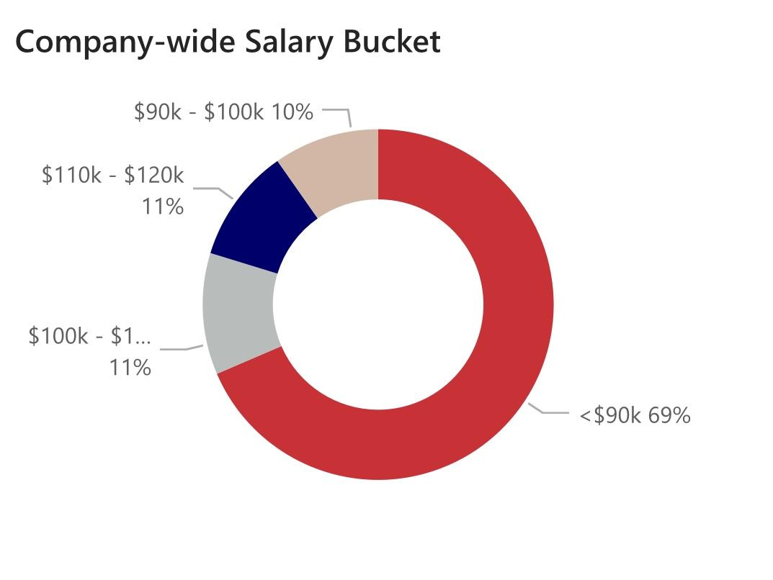
Minimum Salary Requirement
69% of the total employees earn below the minimum salary requirement of $90k.
Notes:
Only 31% earn salaries that complies with the minimum requirement. Across regions, majority of the employees earn salaries below with Kaduna region been the most affected

Slide 11
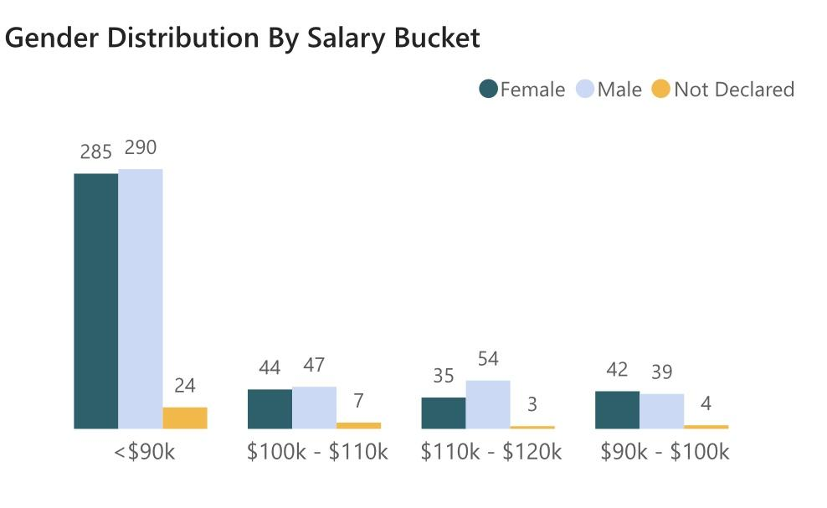
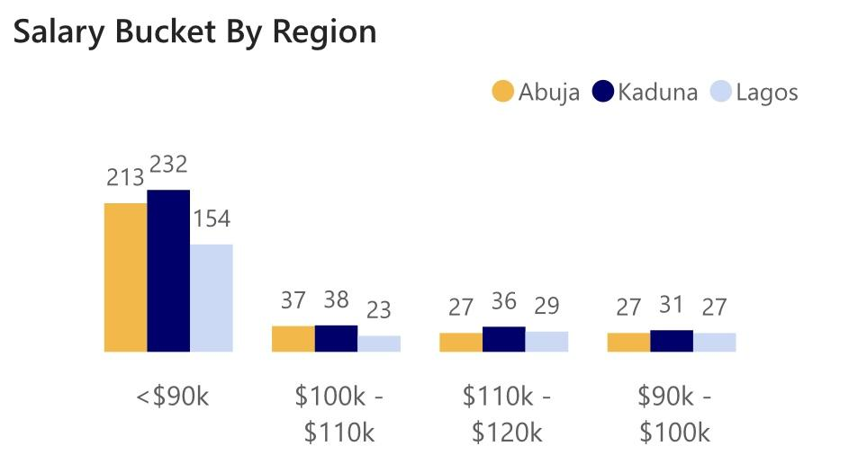
Salary Bucket

Slide 12
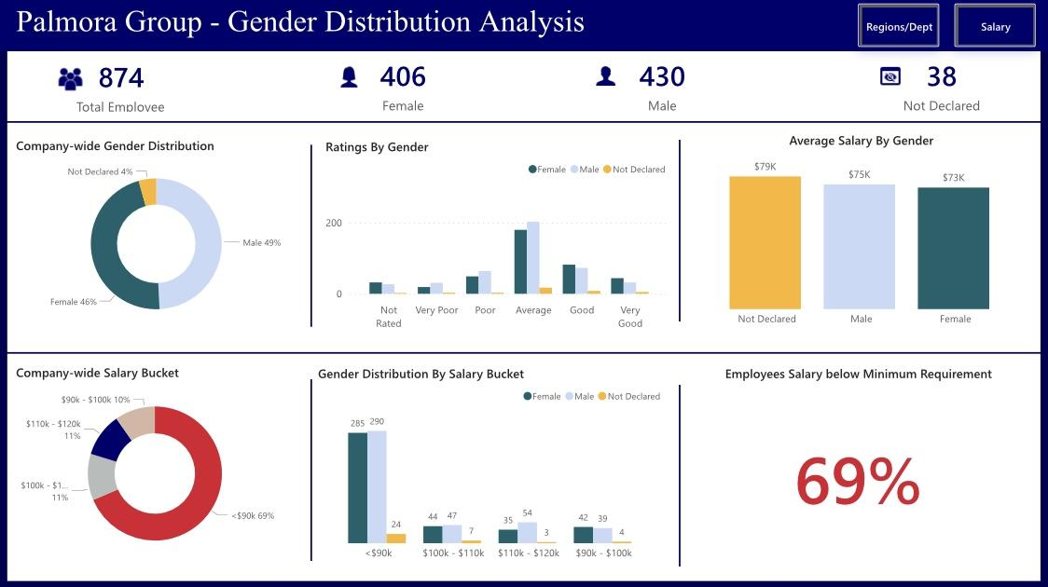
Dashboard
Click here to view Dashboard in Power BI

Slide 13
Remuneration
The total bonus to be paid to employees is $2.03M
The total remuneration (salary + bonus) is approximately $62M
Kaduna - 24M
Abuja - 21M
Lagos - 1M
Click here to view the details

Slide 14
Conclusion
Gender is fairly distributed throughout the organization
Average salary is close for both gender categories but there are far more men than women earning between $110,000 - $120,000
Employees ratings are fairly distributed across the genders
Majority of the employees earn salaries below the minimum requirement

Slide 15
Recommendations
The salaries should be reviewed upwards for the entire organization to ensure the minimum salary requirement is met.
The salary gap between men and women earning between $110,000 - $120,000 should be reviewed for fairness
Gender distribution should be improved on in Kaduna region and across Legal, Support, Sales, and Accounting departments.

Slide 16
Additional Comments
The undisclosed gender category may affect the accuracy of this analysis since the focus of the analysis is on gender distribution and pay parity. However, the undisclosed gender category account for only about 4% of the employees.

Slide 17


